Slide 1

Prediction of Cardiac Arrest Using Machine Learning
By : Avinash Yadav (59)
Vavilashetty Venkat Sai Kumar Shrinivas (57)
Prateek Awate (07)
In Mentored of : Prof. N B Surwade

Slide 2

INTRODUCTION
A heart attack occurs when a coronary artery, one of the arteries that supplies blood to the heart muscle, becomes suddenly blocked.
This sudden blockage stops the blood supply , and the muscle dies. This causes heart attack.
Delay of even few second in cardiac arrest patients are crucial.
so we decide to build a project that can predict cardiac arrest In a person and give information that he is prone to cardiac arrest or NOT.

Slide 3
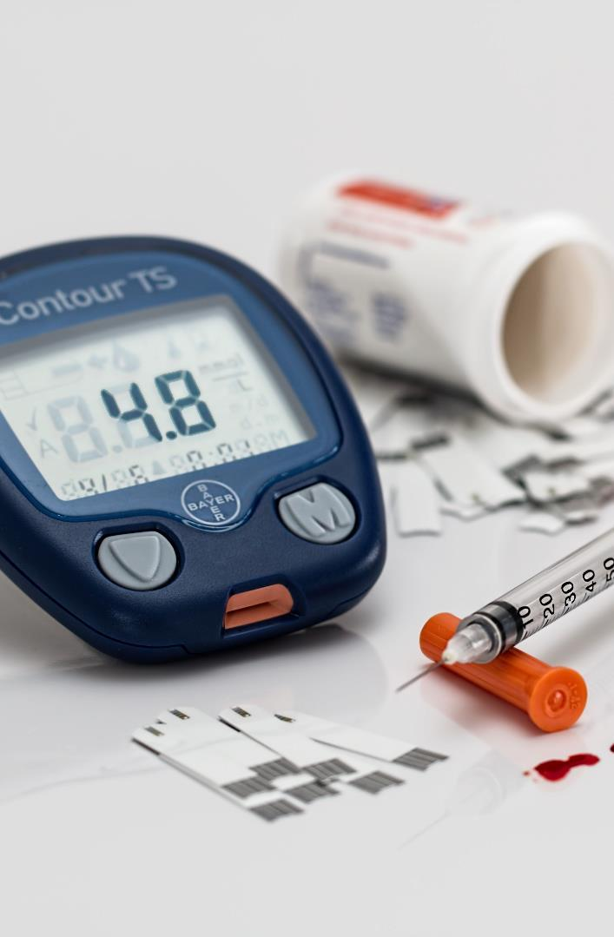
Problem Statement
Through this project we are going to observe different cardiac issues and habits of people which catalyzes the risk of CVD
We will predict whether someone is going to have a cardiac arrest and help people to correct their daily habits which pushes them towards the risk of CVD.

Slide 4
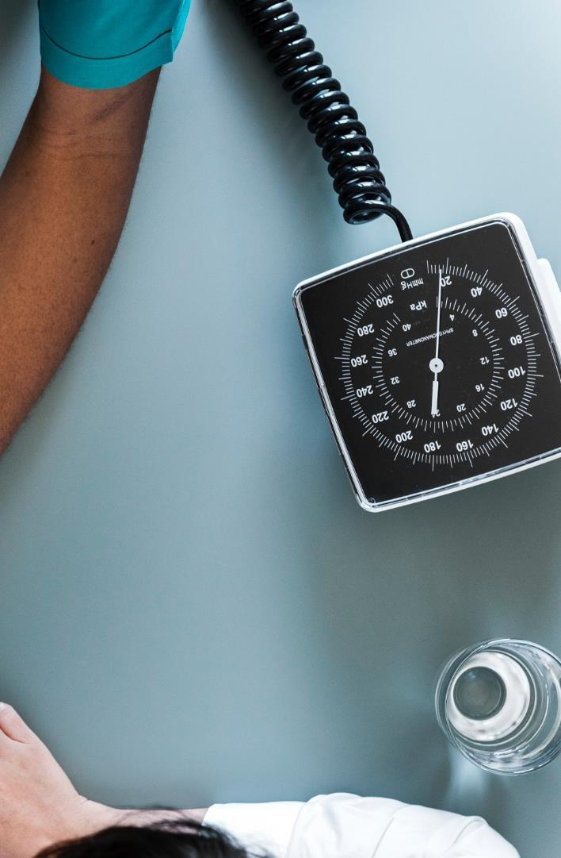
Objectives
Extraction of patient information from standard data set.
Patient information include different attributes such Age, Sex, Cholesterol, Blood pressure, Chest pain and Medical history.
Data cleaning and preprocessing on those datasets.
Using machine learning algorithms to work on those datasets.
Exploring data analysis.
Predicting whether patient will have cardiac arrest or not.

Slide 5
MOTIVATION
In nowadays due to irregular eating habits, poor diet, smoking, pollution and stress cardiac arrest is seeming to happen even for the person in his/her 20’s.
Most of the cardiac arrest are silent and Unpredictable because of which many life’s are lost every year.
It is impractical for a common man to frequently undergo costly tests and thus there needs to be a system in place which is handy and reliable.
So we decided to make a project on prediction of cardiac arrest before it happens and by which many life’s can be saved.

Slide 6

Flow Charts

Slide 7
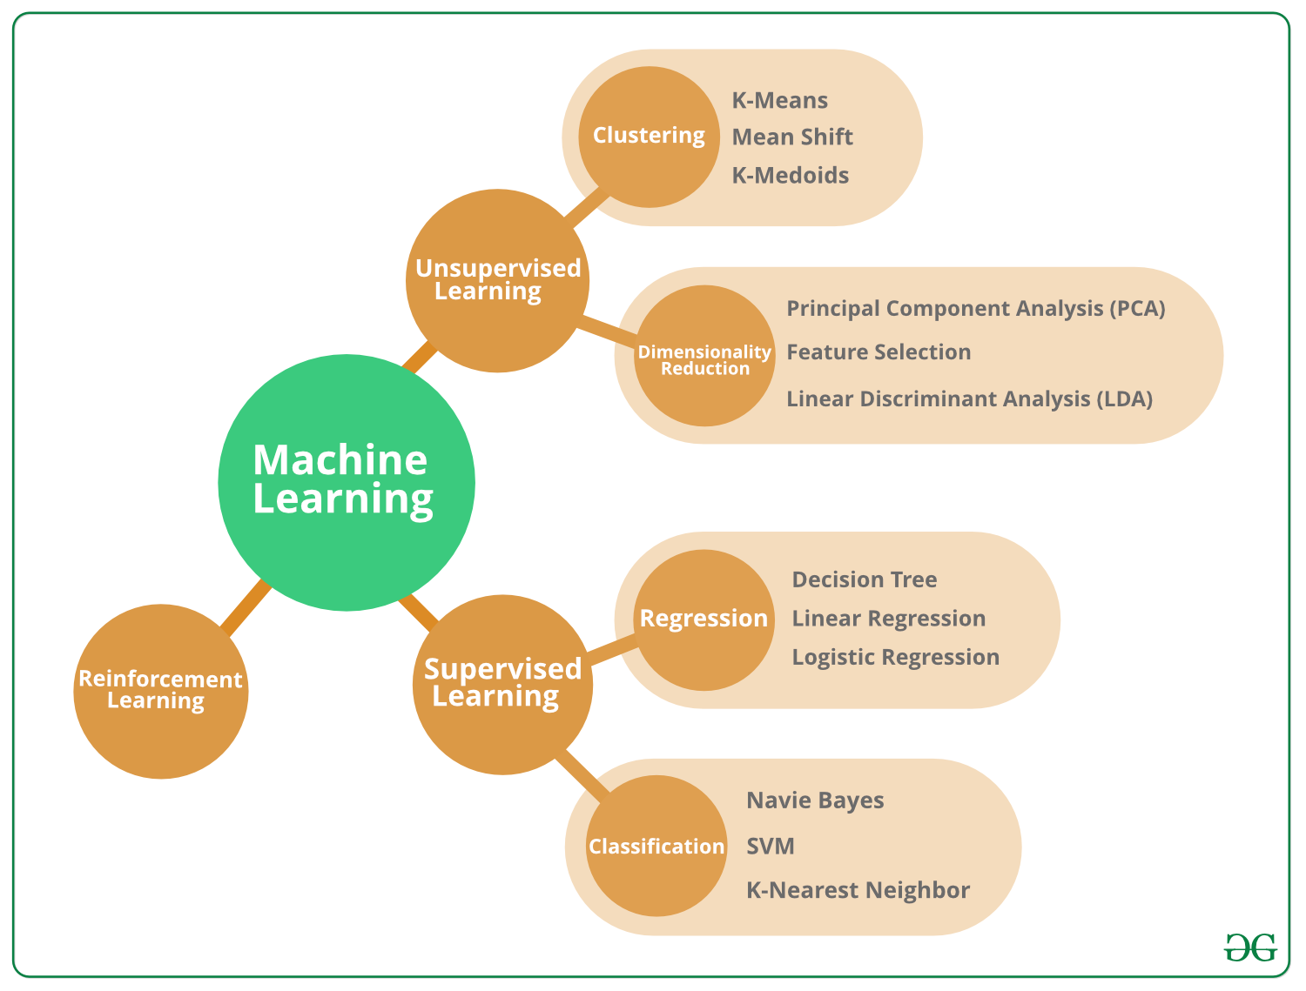
About ML

Slide 8
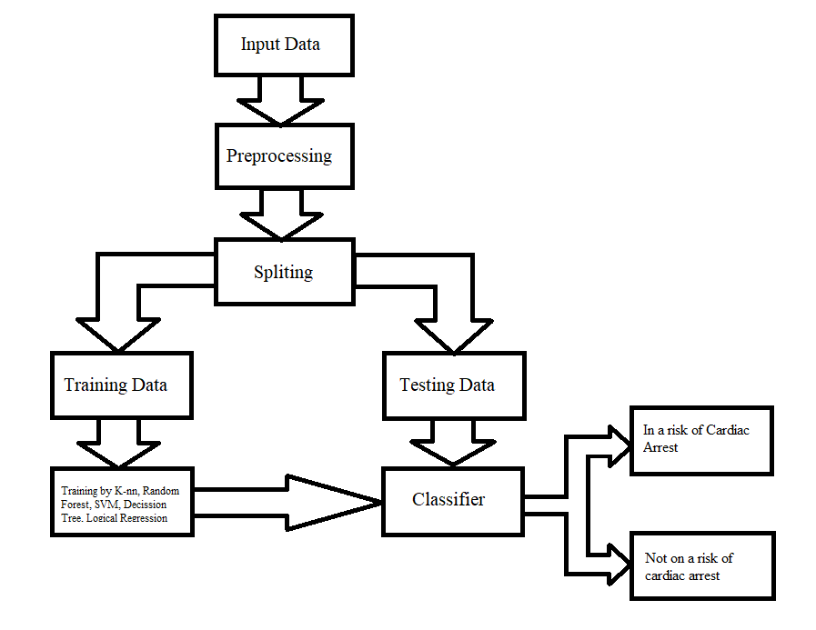
Flowchart of ML model for Cardiac Arrest Prediction

Slide 9
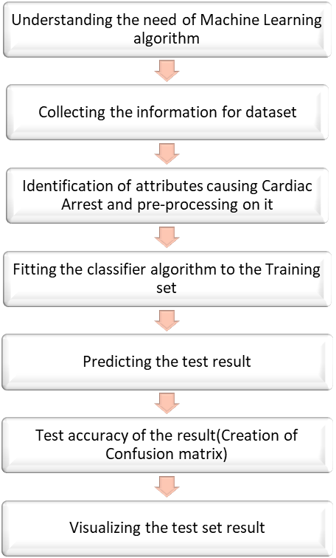
Flow Chart showing Proposed Methodology

Slide 10

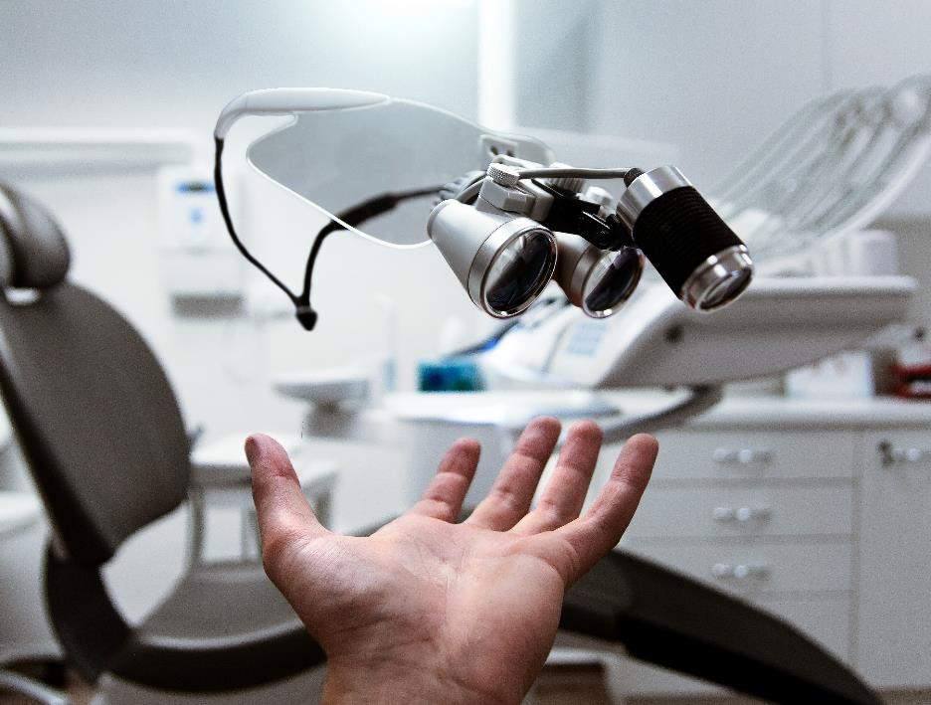
Machine Learning Classifiers Used

Slide 11
K-NN Algorithm
K-Nearest Neighbour is one of the simplest Machine Learning algorithms based on Supervised Learning technique.
K-NN algorithm assumes the similarity between the new case/data and available cases and put the new case into the category that is most similar to the available categories.
K-NN algorithm stores all the available data and classifies a new data point based on the similarity. This means when new data appears then it can be easily classified into a well suite category by using K- NN algorithm.

Slide 12
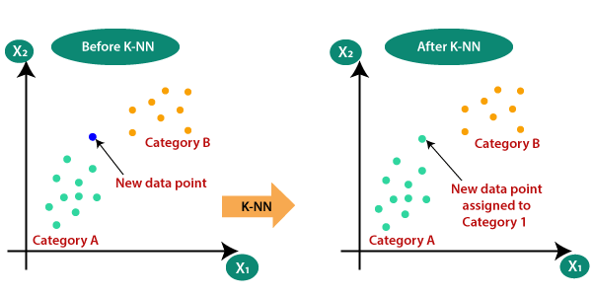
Graphs for k-nn

Slide 13
Support Vector Machine Algorithm
Support Vector Machine or SVM is one of the most popular Supervised Learning algorithms, which is used for Classification as well as Regression problems.
The goal of the SVM algorithm is to create the best line or decision boundary that can segregate n-dimensional space into classes so that we can easily put the new data point in the correct category in the future. This best decision boundary is called a hyperplane.
SVM chooses the extreme points/vectors that help in creating the hyperplane . These extreme cases are called as support vectors, and hence algorithm is termed as Support Vector Machine

Slide 14
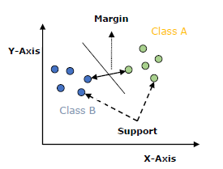
Graph for SVM

Slide 15

Outputs and Observations

Slide 16
Data Gathering
 | age | sex | cp | trestbps | chol | fbs | restecg | thalach | exang | oldpeak | slope | ca | thal | target
0 | 63 | 1 | 1 | 145 | 233 | 1 | 2 | 150 | 0 | 2.3 | 3 | 0.0 | 6.0 | 0
1 | 67 | 1 | 4 | 160 | 286 | 0 | 2 | 108 | 1 | 1.5 | 2 | 3.0 | 3.0 | 1
2 | 67 | 1 | 4 | 120 | 229 | 0 | 2 | 129 | 1 | 2.6 | 2 | 2.0 | 7.0 | 1
3 | 37 | 1 | 3 | 130 | 250 | 0 | 0 | 187 | 0 | 3.5 | 3 | 0.0 | 3.0 | 0
4 | 41 | 0 | 2 | 130 | 204 | 0 | 2 | 172 | 0 | 1.4 | 1 | 0.0 | 3.0 | 0

Slide 17
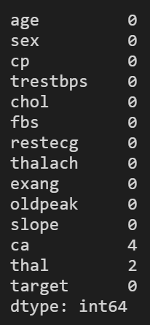
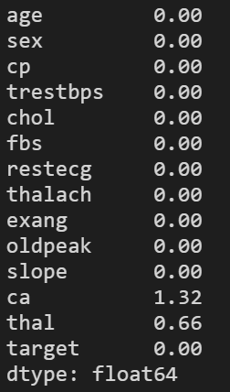
Dropping missing values

Slide 18
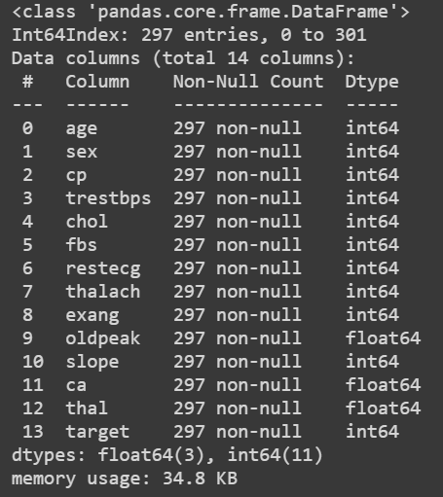
Checking null values

Slide 19
Data Pre processing and data handling
 | age | sex | cp | trestbps | chol | fbs | restecg | thalach | exang | oldpeak | slope | ca | thal | target
count | 303.000000 | 303.000000 | 303.000000 | 303.000000 | 303.000000 | 303.000000 | 303.000000 | 303.000000 | 303.000000 | 303.000000 | 303.000000 | 299.000000 | 301.000000 | 303.000000
mean | 54.438944 | 0.679868 | 3.158416 | 131.689769 | 246.693069 | 0.148515 | 0.990099 | 149.607261 | 0.326733 | 1.039604 | 1.600660 | 0.672241 | 4.734219 | 0.458746
std | 9.038662 | 0.467299 | 0.960126 | 17.599748 | 51.776918 | 0.356198 | 0.994971 | 22.875003 | 0.469794 | 1.161075 | 0.616226 | 0.937438 | 1.939706 | 0.499120
min | 29.000000 | 0.000000 | 1.000000 | 94.000000 | 126.000000 | 0.000000 | 0.000000 | 71.000000 | 0.000000 | 0.000000 | 1.000000 | 0.000000 | 3.000000 | 0.000000
25% | 48.000000 | 0.000000 | 3.000000 | 120.000000 | 211.000000 | 0.000000 | 0.000000 | 133.500000 | 0.000000 | 0.000000 | 1.000000 | 0.000000 | 3.000000 | 0.000000
50% | 56.000000 | 1.000000 | 3.000000 | 130.000000 | 241.000000 | 0.000000 | 1.000000 | 153.000000 | 0.000000 | 0.800000 | 2.000000 | 0.000000 | 3.000000 | 0.000000
75% | 61.000000 | 1.000000 | 4.000000 | 140.000000 | 275.000000 | 0.000000 | 2.000000 | 166.000000 | 1.000000 | 1.600000 | 2.000000 | 1.000000 | 7.000000 | 1.000000
max | 77.000000 | 1.000000 | 4.000000 | 200.000000 | 564.000000 | 1.000000 | 2.000000 | 202.000000 | 1.000000 | 6.200000 | 3.000000 | 3.000000 | 7.000000 | 1.000000

Slide 20
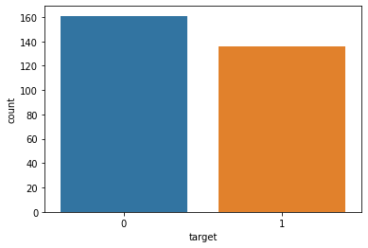
Dataset Balancing
We have 160 person with heart disease and 137 person without heart disease, so our problem is balanced.

Slide 21
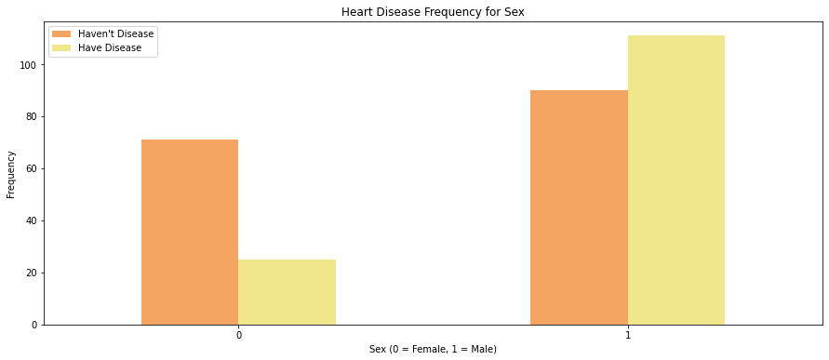
Failure by disease type
Sex
Sex of the person. (1 = male; 0 = female)
We might think that more number of men have heart disease but if we observe closely, we can see that more proportion of female have heart disease as compared to men.

Slide 22
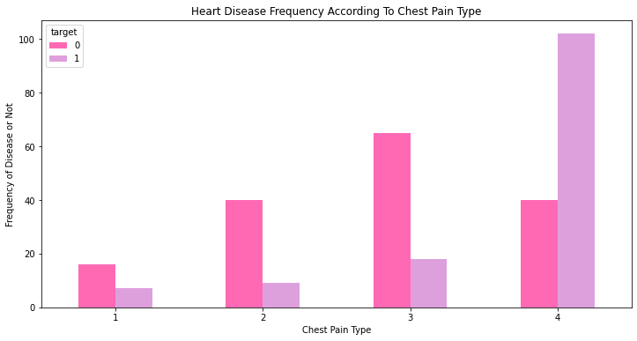
Failure by disease type
Chest pain(cp)
Different Chest Pain Types:
1: Typical angina: chest pain related decrease blood supply to the heart
2: Atypical angina: chest pain not related to heart
3: Non-anginal pain: typically esophageal spasms (non heart related)
4: Asymptomatic: chest pain not showing signs of disease

Slide 23
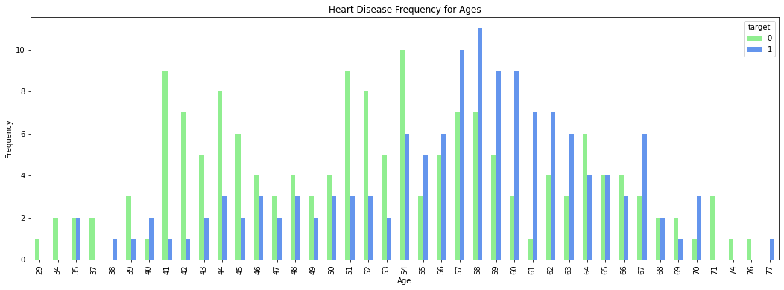
Failure by disease type
Age
There is no particular age at which the person is more prone to having heart disease, which proves that age is just a number.

Slide 24
1. A confusion matrix is a table that is often used to describe the performance of a classification model (or "classifier") on a set of test data for which the true values are known. The classification report visualizer displays the precision, recall, F1, and support scores for the model. 2. There are four ways to check if the predictions are right or wrong: a. TN / True Negative: the case was negative and predicted negative b. TP / True Positive: the case was positive and predicted positive c. FN / False Negative: the case was positive but predicted negative d. FP / False Positive: the case was negative but predicted positive 3. Precision is the ability of a classifier not to label an instance positive that is actually negative. For each class, it is defined as the ratio of true positives to the sum of a true positive and false positive. Precision:- Accuracy of positive predictions. Precision = TP/(TP + FP)

Slide 25
4. Recall is the ability of a classifier to find all positive instances. For each class it is defined as the ratio of true positives to the sum of true positives and false negatives. Recall:- Fraction of positives that were correctly identified. Recall = TP/(TP+FN) 5. The F1 score is a weighted harmonic mean of precision and recall such that the best score is 1.0 and the worst is 0. F1 Score = 2*(Recall * Precision) / (Recall + Precision) 6. Support is the number of actual occurrences of the class in the specified dataset. Imbalanced support in the training data may indicate structural weaknesses in the reported scores of the classifier and could indicate the need for stratified sampling or rebalancing.

Slide 26
K-Nearest Neighbour Result
Train Result:
================================================
Accuracy Score: 86.94%
_______________________________________________
F1 Score: 0.85
_______________________________________________
CLASSIFICATION REPORT:
0 1 accuracy macro avg weighted avg
precision 0.859375 0.882979 0.869369 0.871177 0.870114
recall 0.909091 0.821782 0.869369 0.865437 0.869369
f1-score 0.883534 0.851282 0.869369 0.867408 0.868861
support 121.000000 101.000000 0.869369 222.000000 222.000000
_______________________________________________
Confusion Matrix:
[[110 11]
[ 18 83]]

Slide 27
Test Result:
================================================
Accuracy Score: 80.00%
_______________________________________________
F1 Score: 0.77
_______________________________________________
CLASSIFICATION REPORT:
0 1 accuracy macro avg weighted avg
precision 0.760870 0.862069 0.8 0.811469 0.809445
recall 0.897436 0.694444 0.8 0.795940 0.800000
f1-score 0.823529 0.769231 0.8 0.796380 0.797466
support 39.000000 36.000000 0.8 75.000000 75.000000
_______________________________________________
Confusion Matrix:
[[35 4]
[11 25]]

Slide 28
SVM result
Train Result:
================================================
Accuracy Score: 92.79%
_______________________________________________
F1 Score: 0.92
_______________________________________________
CLASSIFICATION REPORT:
0 1 accuracy macro avg weighted avg
precision 0.906977 0.956989 0.927928 0.931983 0.929730
recall 0.966942 0.881188 0.927928 0.924065 0.927928
f1-score 0.936000 0.917526 0.927928 0.926763 0.927595
support 121.000000 101.000000 0.927928 222.000000 222.000000 _______________________________________________
Confusion Matrix:
[[110 11]
[ 18 83]]

Slide 29
Test Result:
================================================
Accuracy Score: 84.00%
_______________________________________________
F1 Score: 0.81
_______________________________________________
CLASSIFICATION REPORT:
0 1 accuracy macro avg weighted avg
precision 0.787234 0.928571 0.84 0.857903 0.855076
recall 0.948718 0.722222 0.84 0.835470 0.840000
f1-score 0.860465 0.812500 0.84 0.836483 0.837442
support 39.000000 36.000000 0.84 75.000000 75.000000
_______________________________________________
Confusion Matrix:
[[37 2]
[10 26]]

Slide 30
Accuracies of Classifiers Used
 | Train Accuracy | Test Accuracy
K-Nearest Neighbor | 86.94 | 80.0
Support Vector Machine | 92.79 | 84.0

Slide 31
Project Strategy
How will we scale in the future
Phase 1 2020
Phase 2 2021
Currently due to the increase in pollution and unhealthy lifestyle practices there is a huge chances for cardiac arrest in a person and may be also a common problem in future. So we have build a project using machine learning and algorithm to predict the possibility of cardiac arrest.
In phase 1 we have predicted cardiac arrest using machine learning using limited data and classifiers.
In this phase we have predicted whether a person is going to have cardiac arrest or not.
In future we will increase its accuracy by adding more classifier and by adding more datasets
In future we will try to add a feature so that anyone can manually input his data and get prediction of cardiac arrest.

Slide 32

Summary
In this presentation we have summarized state of art techniques and available methods for prediction of this disease.
Some methods of machine learning has been discussed and analytical comparison has been done for finding out best available algorithm for medical dataset.
In future our aim is to carry forward the work of temporal medical dataset, where dataset varies with time and retraining of dataset is required.

Slide 33
Thank You

